Slide 1
工作总结
2/1
杨易趣

Slide 2
实现六个基础api_function
search_object
grab_object
move_to_object
move_to_coordinates
release_object
open_container
位于previous_llm_yyq\skills_python中
除open_container外，其余func均可通过post/get操纵机械臂

Slide 3
实现了grounded sem识别物体并计算深度
之前遇到的大部分问题在增加一个固定摄像机的基础上应该都能得到解决与优化。
也实现了计算物体质心位置宽度便于机器人抓取。

Slide 4
实现了vision与llm的结合
通过多线程，过程中定期更新环境信息(每30秒更新一次)
task = "move the cola can to the plate"
t1 = Thread(target=main, args=(task,result_queue,response_all))
t2 = Thread(target=generate_env)

Slide 5
实现了自动根据历史推理信息生成新技能的python及json，txt（description）文件
Py文件包含了自动生成的import与函数，并储存于skills_library中
Json文件用于经过修改后添加于TOOLS中
Txt文件用于更新到知识库（skill_library）中(参考下一页)

Slide 6
可以成功执行简单指令
e.g.
The image shows a scene with two cans and one bowl on a table. One can is red, while the other is black. There's also a white plate placed between them. All these items seem to be arranged neatly on the gray surface of the table.
Task: move the cola can to the plate
Initial env: a scene with two cans and one bowl on a table. One can is red, while the other is black. There's also a white plate placed between them. All these items seem to be arranged neatly on the gray surface of the table.
Thought: I need to find the cola can first.
Action: search_object
Action Input: {"object_name": "cola can"}
API output: {'cola can': (260, 314, 319)}
________________________________________________________________
Status: Robot is grabing nothing.
Environment: two cans of soda, one red and white can on the left side of the table and another silver can with blue writing on it to its right. There is also a bowl placed between these two cans. In front of this arrangement there's a black object which appears to be some sort of machine or equipment.
Thought: I have found the location of the cola can. Now, I need to go there and grab it.
Action: move_to_object
Action Input: {"object_name": "cola can"}
b'Call move_arm_position failed'
API output: Success move, move to (260, 314, 319), and is grabbing []
________________________________________________________________

Slide 7
Status: Robot is grabing nothing.
Environment: two cans of soda, one red and white can on the left side of the table and another silver can with blue writing on it to its right. There is also a bowl placed between these two cans. In front of this arrangement there's a black object which appears to be some sort of machine or equipment.
Thought: I have reached the location of the cola can. Now, I need to grab it.
Action: grab_object
Action Input: {"object_name": "cola can", "tableware_name": "hand"}
{'enable': 0, 'width': 89, 'depth': 319}
b'Call move_arm_position failed'
API output: Success grab object: cola can by hand
________________________________________________________________
Status: Robot is grabing ['cola can by hand']
Environment: two cans of soda, one red and white can on the left side of the table and another silver can with blue writing on it to its right. There is also a bowl placed between these two cans. In front of this arrangement there's a black object which appears to be some sort of machine or equipment.
Thought: I have grabbed the cola can. Now, I need to find the plate.
Action: search_object
Action Input: {"object_name": "plate"}
API output: {'plate': (405, 315, 504)}
________________________________________________________________
Status: Robot is grabing ['cola can by hand']
Environment: two cans of soda, one red and white can on the left side of the table and another silver can with blue writing on it to its right. There is also a bowl placed between these two cans. In front of this arrangement there's a black object which appears to be some sort of machine or equipment.
Thought: I have found the location of the plate. Now, I need to go there.
Action: move_to_object
Action Input: {"object_name": "plate"}
b'Call move_arm_position failed'
API output: Success move, move to (405, 315, 504), and is grabbing ['cola can']
________________________________________________________________

Slide 8
Status: Robot is grabing ['cola can by hand']
Environment: two cans of soda, one red and white can on the left side of the table and another silver can with blue writing on it to its right. There is also a bowl placed between these two cans. In front of this arrangement there's a black object which appears to be some sort of machine or equipment.
Thought: I have reached the location of the plate. Now, I need to release the cola can.
Action: release_object
Action Input: {}
b'Call move_arm_position failed'
API output: Success release object.
________________________________________________________________
Status: Robot is grabing nothing.
Environment: two cans of soda, one red and white can on the left side of the table and another silver can with blue writing on it to its right. There is also a bowl placed between these two cans. In front of this arrangement there's a black object which appears to be some sort of machine or equipment.
Thought: The task has been accomplished.
Final Response: The cola can has been successfully moved to the plate.
Final Response: Thought: The task has been accomplished.
Final Response: The cola can has been successfully moved to the plate.

Slide 9
知识库更新
通过调用langchain_chatchat的API接口，
requests.post(
"http://127.0.0.1:7861/knowledge_base/upload_docs", data=data, files=files
)
现已将基本函数的description文件统一更新到了知识库（skill_library）并向量化
当新产生新的函数后，同时也更新进知识库并向量化

Slide 10
EXAMPLE

Slide 12
可以通过相似度提取出对应函数的description信息
暂时没有对文件进行split处理（chunk_size设置的足够大）。所以是对于每个函数完整的description向量化后的文件于task进行相似度比较
将相似度高的函数的description添加进prompt，打算进行下一步操作。（进行中）

Slide 13
执行步骤
等待机械臂控制平台启动
进入langchain_chatchat文件，终端执行python startup.py -a等待其运行（在需要根据相似度选择函数时，否则忽略）
执行previous_llm_yyq\web_demo_api.py文件等待其运行
执行previous_llm_yyq\test_未分任务 _开箱.ipynb（暂时文件内测试代码多，后半部分比较混乱）

Slide 14
待解决问题(已有思路）
解决函数skills_python中函数import问题，采用class替代global var. 在添加新函数时，也需要更新__Init__.py文件（应该不难吧…）
主文件（test）中：
class A --(store variable)
a = A（）
from skills_python import func_
func=func_ (a)
tool_wrapper_for_qwen(func)
Skill_library/func.py中
def func_(a):
def func(param):
……
return func
def func(param):
……
其中所有的原先的global变量改为a.变量
class a 可以在test_react和test文件中传递，
根据以上重新修改prompt对import的定义：
如果有用到func，则From skills_python import func_并且执行 func=func_(a)
根据以上重新修改prompt对function的定义：
需符合：
def func_(a):
def func(param):
……
return func
其中func是新总结函数。
已解决

Slide 15
待解决问题（还没思路）
搞清楚embedding keyword怎么具体发挥作用，并且动态更新其中的值（伴随着新函数的生成）
怎么能够让description：
move_item_to_location: Call this tool API to control the robot. What is the Move Item to Location API useful for? Moves an item from its current location to a specified destination. Parameters: [{"name": "item_name", "type": "string", "description": "The name of the item to be moved.", "required": true}, {"name": "destination_name", "type": "string", "description": "The name of the destination where the item should be moved.", "required": true}] Format the arguments as a JSON object.
更利于向量化与相似度匹配，或者换成更利于理解的语言
可以让llm直接对所有的tool_name进行一个可能性筛选，eg.1.筛选三个在某task下最可能用到的tool，2.再将可能用到的tool的相关txt文档放到React_Prompt中便于产生thought等，见后面的ppt

Slide 16
工作总结
2/28
杨易趣

Slide 17
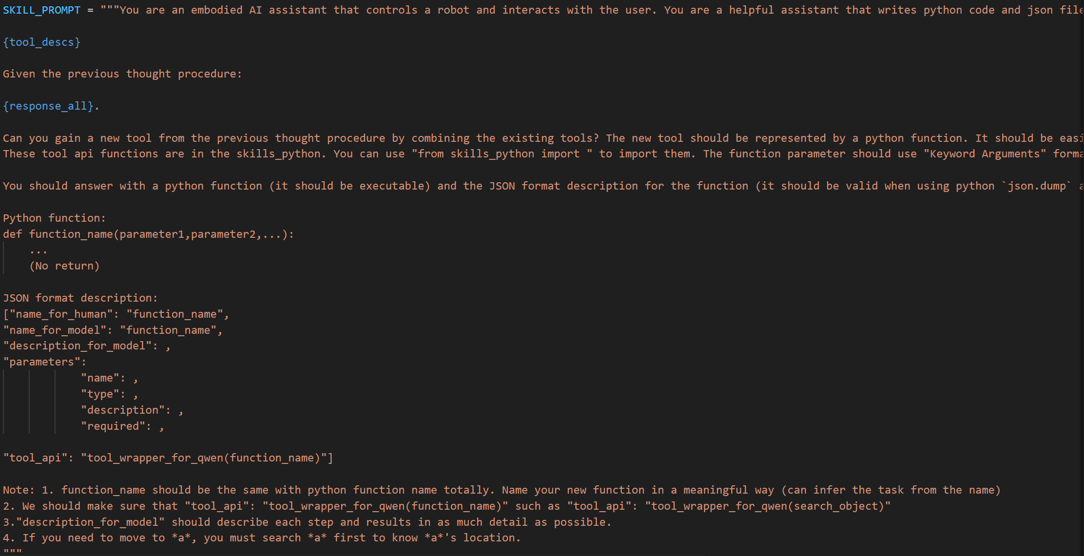
实现add_skill函数根据历史信息利用llm提炼新的skill
Prompt：

Slide 18
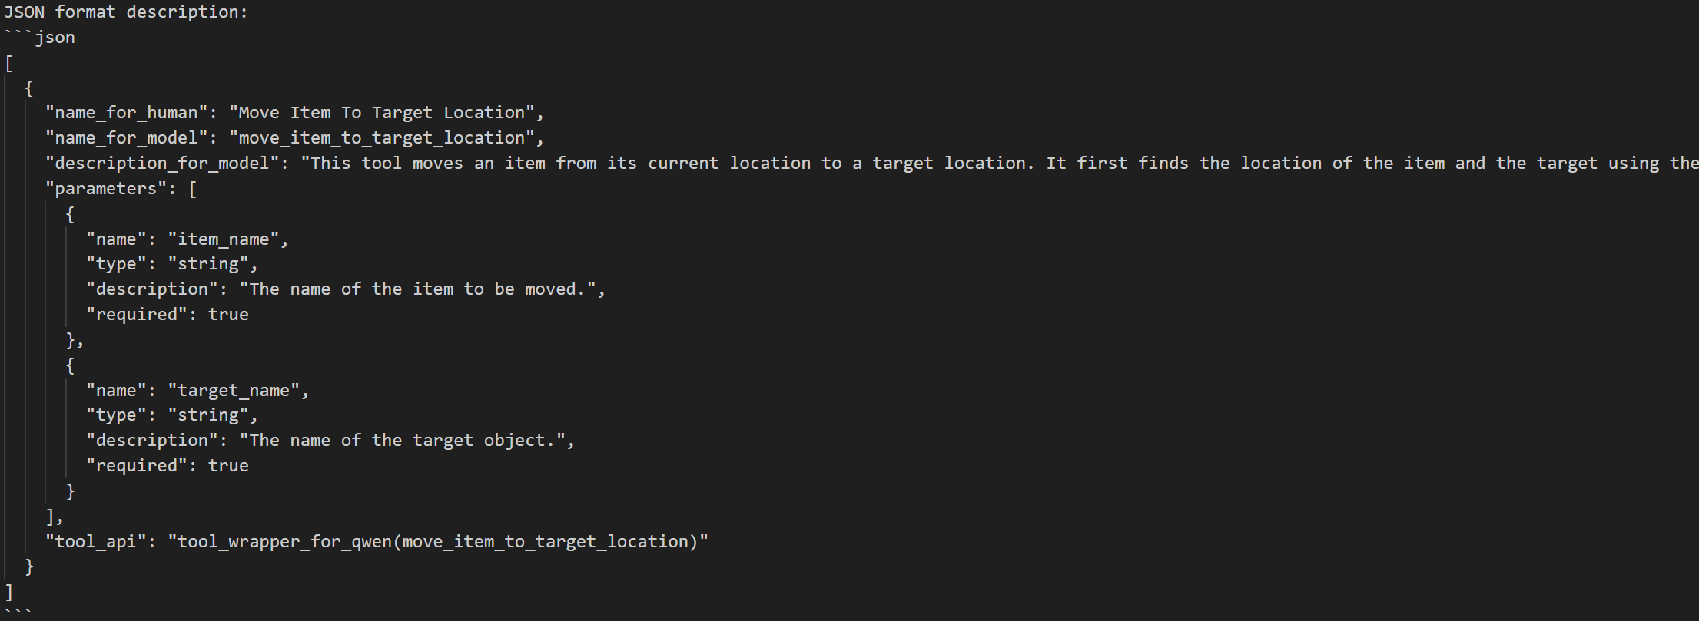
Output example:
同时
1.也会把python代码保存到skills_python module中，并更改模块的__init__.py部分，保证函数能够顺利导入其他文件
2.把json代码部分，转化为文字描述txt并保存于new_skill文件夹下，并上传至向量数据库（此步适用于用向量数据库来筛选task相关skill）
3.在embedding_keyword.txt中添加函数名（此步是为了后来精进embedding模型的提前打算）

Slide 19
实现了delete_skill来删除skills_python中现有的skill
会删除skill_python中的对应skill的python代码，并修改__init__.py文件
删除new_skill文件夹下中对应函数描述的txt文件，并且在向量知识库中删除对应的文件
删除embedding_keyword.txt中的对应函数名称

Slide 20
将现有的skill(tool)进行划分
其余通过add_skill产生的均为integrated tools

Slide 21
用llm筛选出对于实现任务可能有关的tool
Prompt：
https://devops.aliyun.com/lingma/login?state=2-dcfcf2512d98404597318b683bdd0b9f&port=37510
具体实现位于related_skill.py 中的"related_skill" function ，其中tools是现有所以函数的名称＋description（除去了那些多余的关于parameter的描述）
example：
task="move the cola can to the plate and move the cola can to basket"
Output:
表现不错，但可以再改进prompt，可以提高Integrated tool的优先级。

Slide 22
利用通过llm筛选的相关tool，来完成机械臂任务指令
主函数为main3
输出示例：
这是通过related_skill筛选出来的skill
这是调用机械臂的反馈

Slide 23
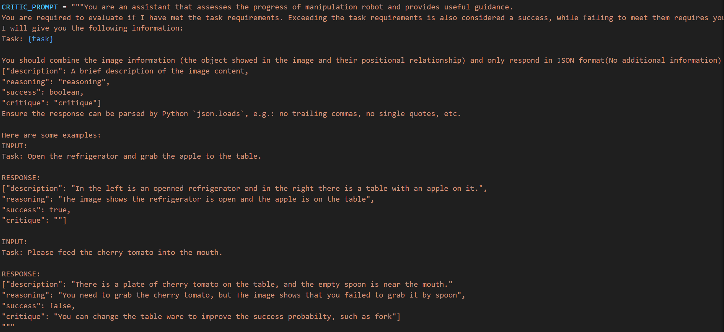
自我验证模块
prompt

Slide 24
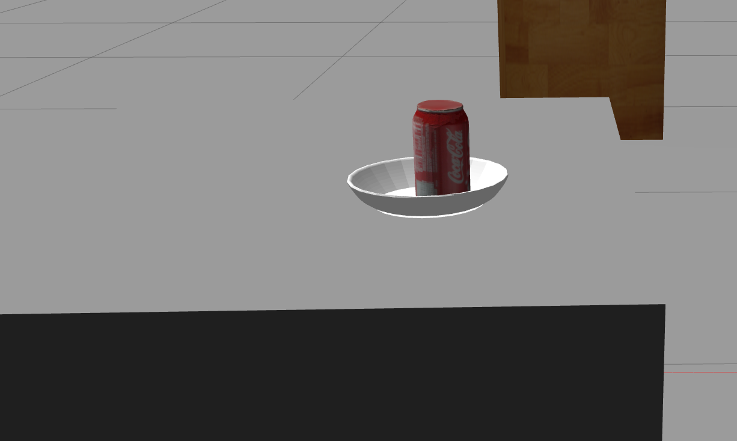
自我验证示例：
"description": "A plate is on the left side of the table and a red cola can is on the right side of the table.",
"reasoning": "To complete the task, the cola can needs to be moved to the same location as the plate. In the image, both objects are on the table, but they are not in the same location. Therefore, the task has not been completed.",
"success": false,
"critique": "To successfully complete the task, the cola can should be moved to the same location as the plate."
Input：
output：
"description": "A red Coca-Cola can is placed inside a white plate, which is located on a gray surface. To the right of the plate, there is a wooden structure.", "reasoning": "The image shows the exact location of the Coca-Cola can and the plate. The can is already inside the plate, so the task has been completed successfully.", "success": true,
"critique": ""
效果都还不错，具有可信度

Slide 25
现在实现了三种方式完成task
Main 最原始的只使用test_react.py中定义的tool
Main2 使用自定义module skills_python中的tool，筛选task相关tool时采用向量数据库中的文本相似度匹配
Main3 使用自定义module skills_python中的tool，使用了llm来筛选task可能会使用到的tool
总结：
目前main3比main2表现得更好

Slide 26
待解决问题
虽然实现了self_verification模块，但是还没有运用到整体系统中
运用思路：
在task执行完毕时，验证是否真的实现成功从而再返回final response。
问题：但是如果中途出现了比如grab_object的失败，怎么能够及时的出现失败的反馈，是通过自我验证模块还是通过定期环境识别?(目前环境识别是每30秒一次，如果通过定期环境识别来检测中间出现的纰漏，那么得更加频繁的进行环境识别，但是本身环境识别就耗时较久可能没法及时捕捉到）
在new_skill通过add_skill生成时，验证生成函数的逻辑正确
目前可以通过exec()识别new_skill function是否有语法错误。但是就错误的逻辑如何识别出来?比如对于之前提到的新函数move_item_to_target_location(item_name, target_name)，检验是否有逻辑错误可能只能通过再给个item_name和target_name真实的跑一遍再进行self_verification验证是否成功，但是是否又需要llm根据环境产生对应的参数值，不然如果自定义item_name和target_name又不够自动化。
向量数据库的途径有没有什么改进的方法
等回滚api设计好后，在add_skill前进行一次回滚
写prompt让其根据新函数的description和task再生成一下新函数的参数
重新运行一下新函数，通过self_verification来验证是否task执行成功
先做一些关于query改写的survey
已解决，见下一页ppt

Slide 27
等回滚api设计好后，在add_skill前进行一次回滚
写prompt让其根据新函数的description和task再生成一下新函数的参数
重新运行一下新函数，通过self_verification来验证是否task执行成功
改进add_skill，在生成python代码后进行判断：
1. 是否有语法错误
2. 是否有逻辑错误
如果无错误，再执行一系列的添加文件，更新数据库的措施

Slide 28
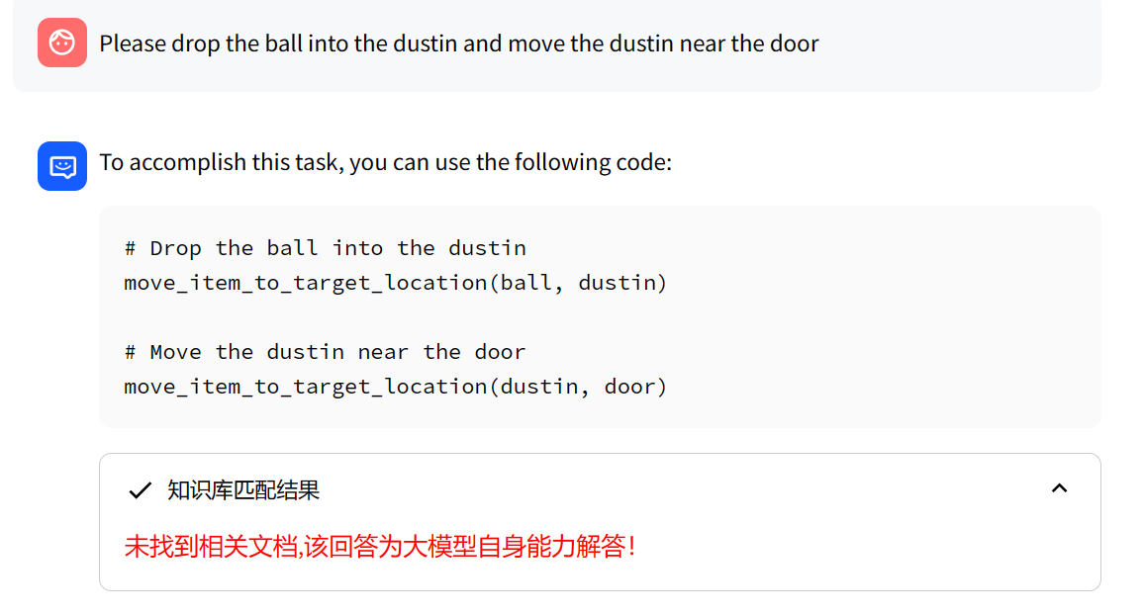
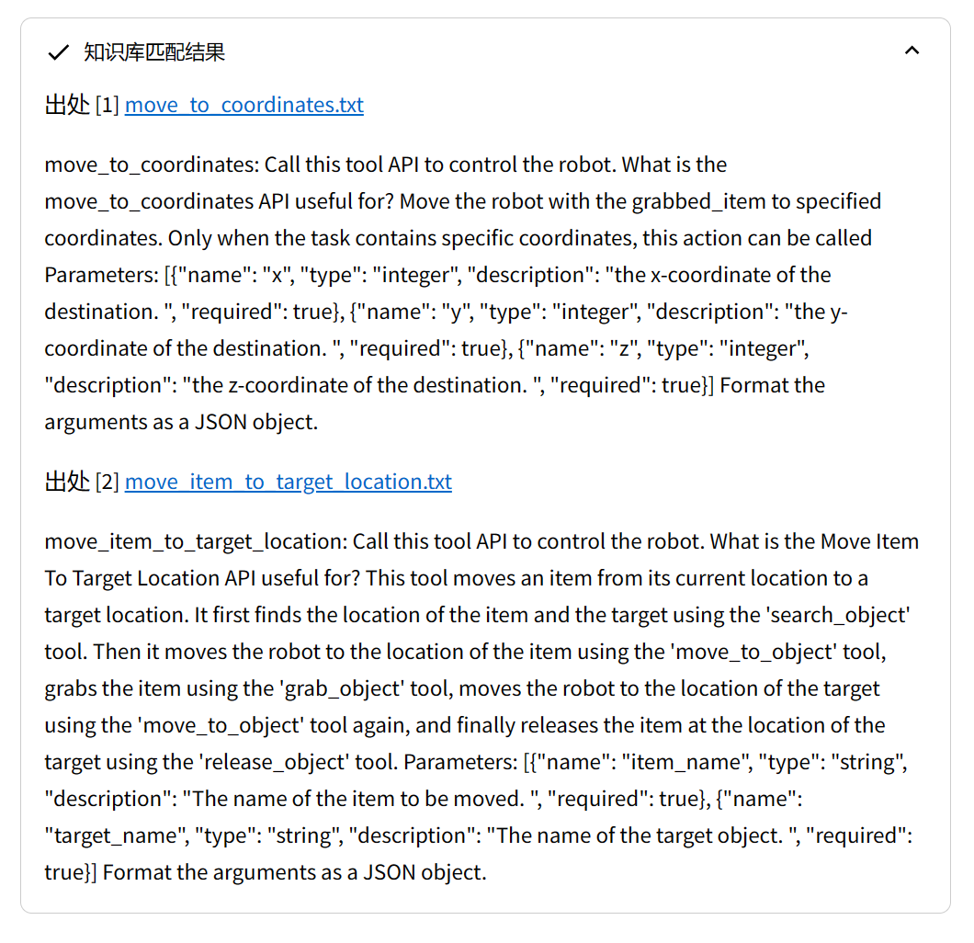
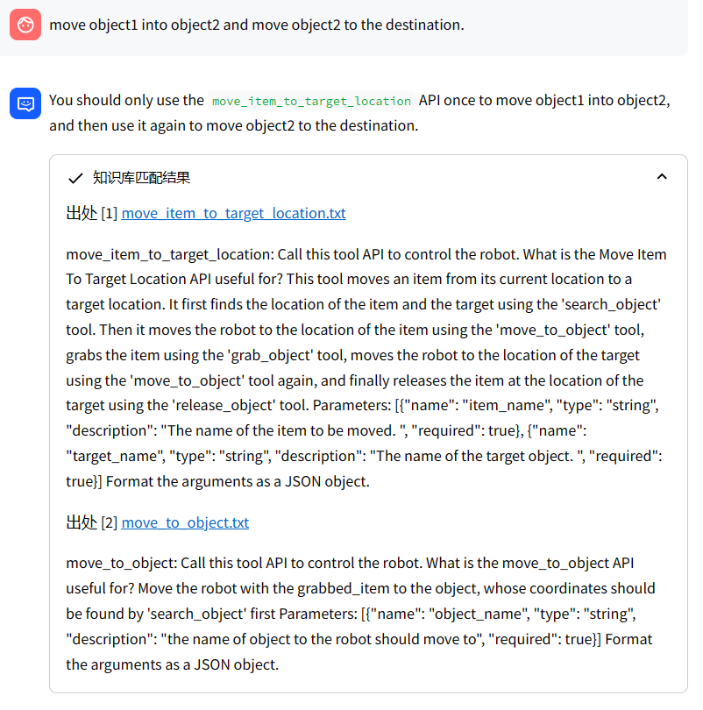
Skill_library匹配 examples
<Instruction>Answer questions concisely and professionally based on the known information. If the answer cannot be obtained from it, say "I cannot answer this question based on the known information" in English.</Instruction>"
<Known Information>{{ context }}</Known Information>
The robot has {{ tool_name }}
<Question>{{ question }}</Question>
Query_rewrite.py
回答的結果是對的，但是沒有匹配成功
解決方法：把query改寫成更易匹配的通用模式
Perfect example，但是这样直接输入的结果不稳定

Slide 29
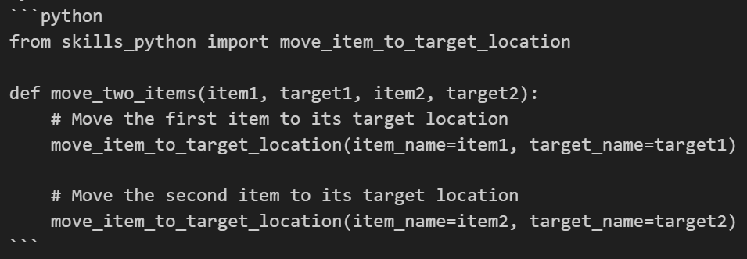
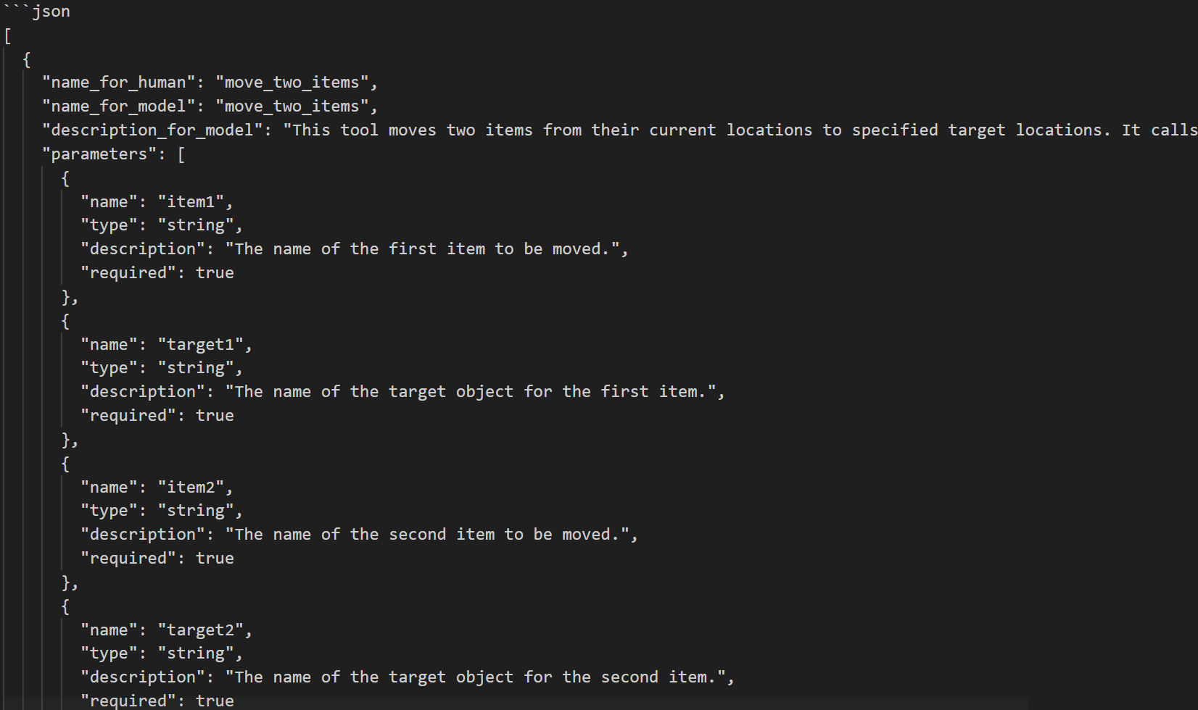
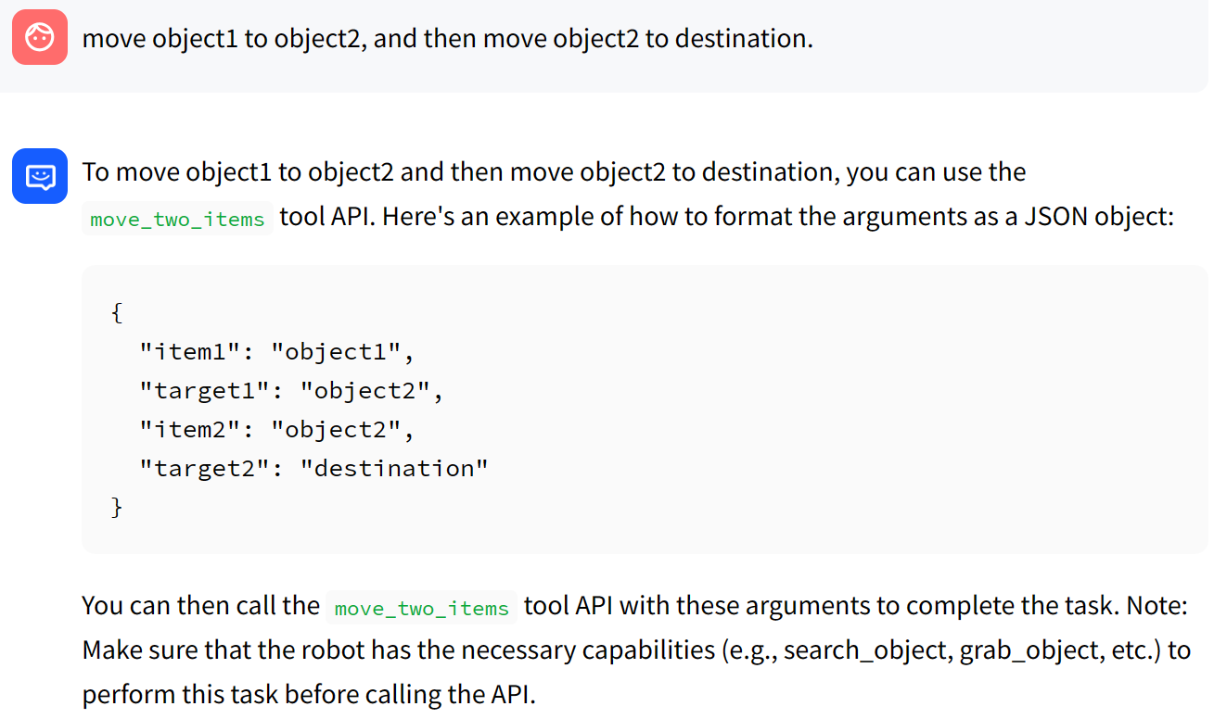
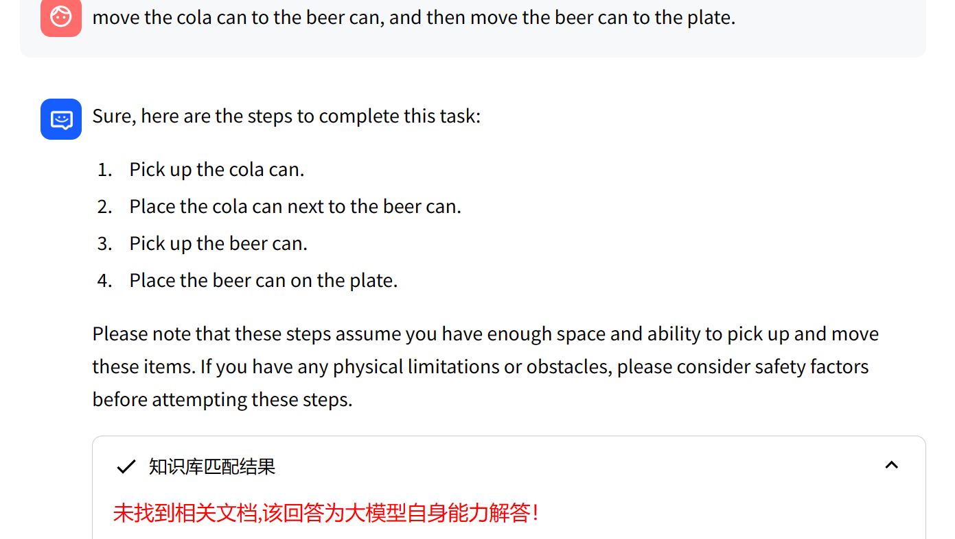
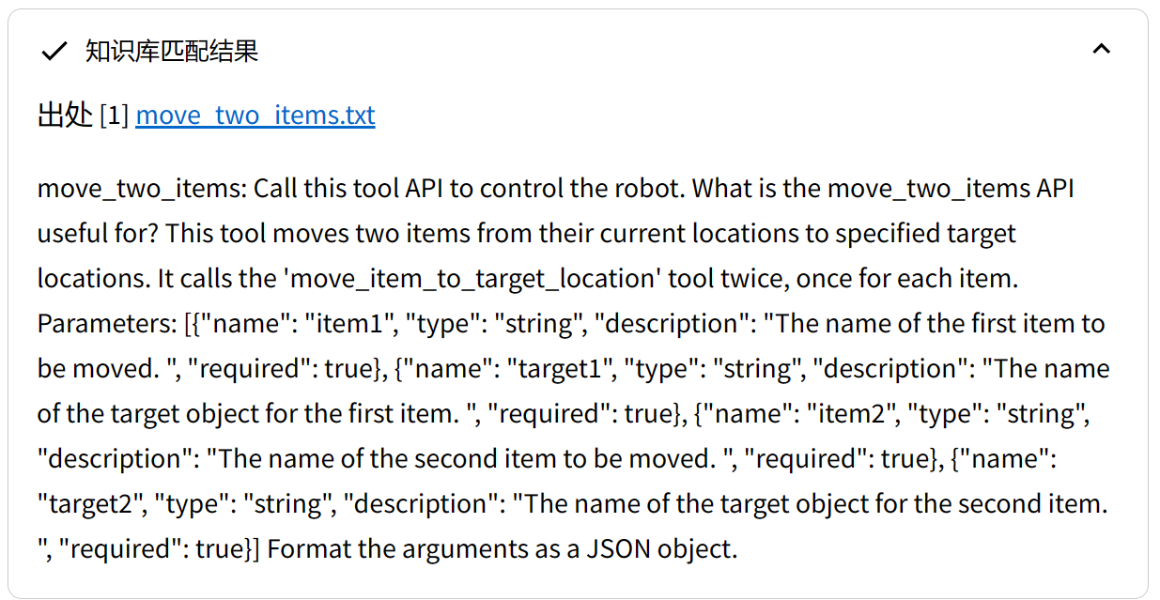
Skill_library匹配 examples 2
如果此时生成一个新的函数，会有更加匹配的解决办法
"""
Task: move the cola can to the beer can, and then move the beer can to the plate.
Initial env: three items placed on a wooden surface against a gray background. On the left side of the table, there is an upright can with blue and white stripes labeled "ST". In front of this can, slightly to its right, sits a round plate. To the far right of the scene stands another can, which has red and green labels and appears to be from Coca-Cola. All these objects seem to be stationary and not interacting with each other.
Thought: I need to move the cola can to the beer can first. I'll use the 'move_item_to_target_location' tool for this.
Action: move_item_to_target_location
Action Input: {"item_name": "cola can", "target_name": "beer can"}
API output: Success accomplish move_item_to_target_location with {"item_name": "cola can", "target_name": "beer can"}
________________________________________________________________
Status: Robot is grabing nothing.
Environment: several objects on a table, including two cans and a bowl. There is an orange can with white text located towards the right side of the table. Another red can with white text is situated to its left. A round white plate rests between these two cans, slightly closer to the viewer than them. Additionally, there's another smaller object resembling a bottle cap or ring near the center-right part of the table.
Thought: I have successfully moved the cola can to the beer can. Now, I need to move the beer can to the plate using the 'move_item_to_target_location' tool.
Action: move_item_to_target_location
Action Input: {"item_name": "beer can", "target_name": "plate"}
API output: Success accomplish move_item_to_target_location with {"item_name": "beer can", "target_name": "plate"}
________________________________________________________________
Status: Robot is grabing nothing.
Environment: several objects on a wooden table against a gray background. First, there's an upright can of soda with its cap removed and placed to one side. Next is a bowl which seems empty or clean as it sits next to another can without any visible contents inside. Lastly, two cans lie horizontally across each other near these items - they might be empty too but their caps remain intact. Overall this scene gives off an impression of someone having recently finished drinking from both cans before putting them down alongside some food containers like bowls for later use when hungry again soon enough after eating what was served earlier today during lunchtime perhaps?
Thought: I have successfully moved the beer can to the plate. The task has been accomplished.
Final Response: The cola can has been moved to the beer can, and the beer can has been moved to the plate. The task is now complete.
Final Response: Thought: I have successfully moved the beer can to the plate. The task has been accomplished.
Final Response: The cola can has been moved to the beer can, and the beer can has been moved to the plate. The task is now complete.
"""
add_skill.py
rewritten query
加入skills_library后进行测试
发现查询不到相关文档时，用query_rewrite.py改写query

Slide 30
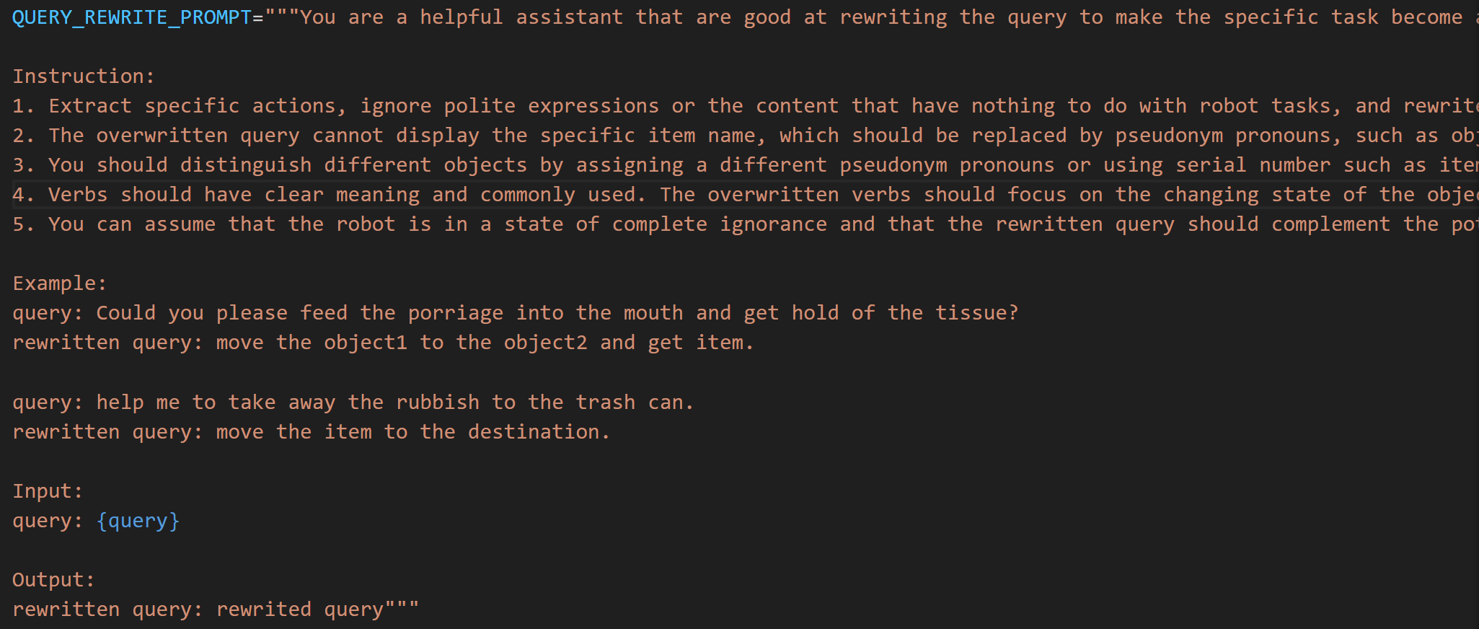
query_rewrite function prompt
example:
query="please carry the bag to the desk and then find the pencil near the desk"
rewritten query=”move the object1 to the destination1 and locate the object2 near the destination1”

Slide 31
抓不准怎么办？校准深度值
未解决，暂时忽略
$$\sqrt[2]{(x^2+y^2}$$
z
相片中心
到中心的深度则是：
深度相机的depth
真正的depth
+width/2
（x,y是到中心的距离，而非左上角）
注：此方法只适用于圆柱物体，具体修正需要有点云数据
摄像头位置

Slide 32
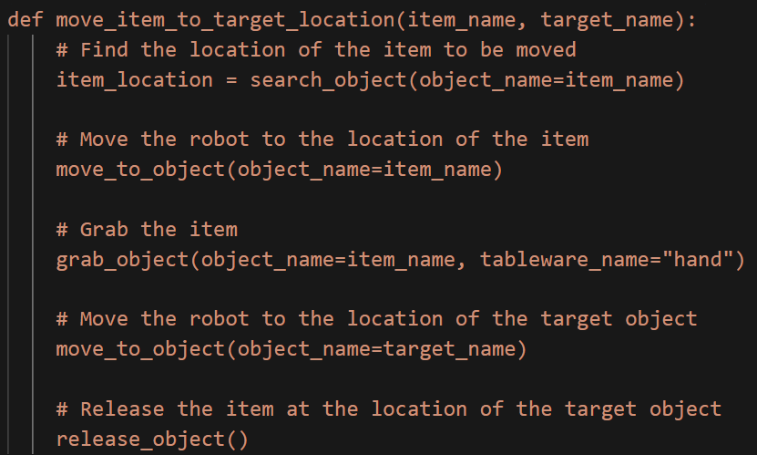
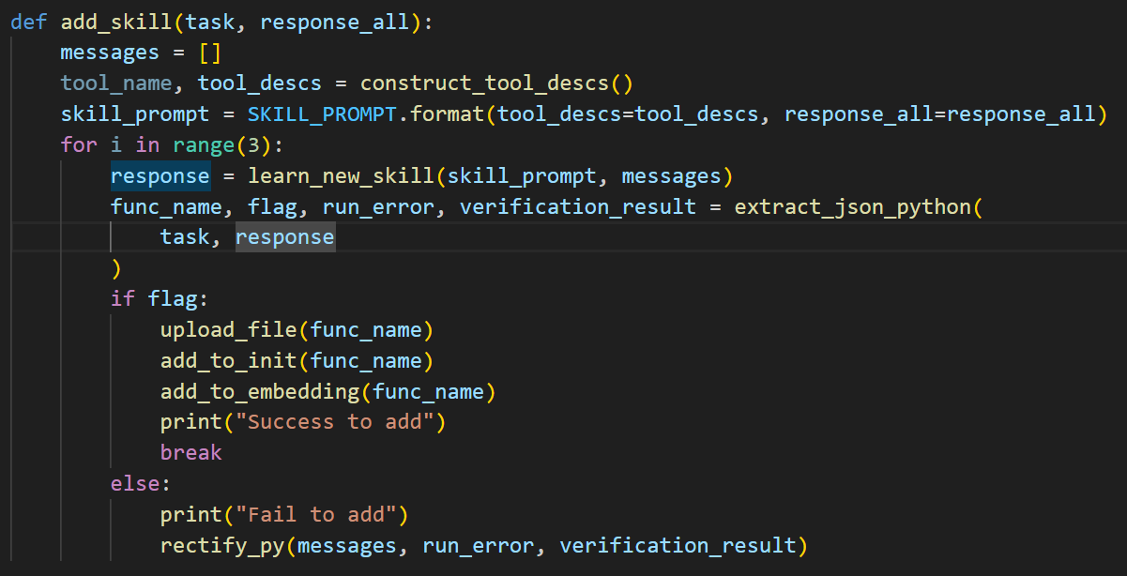
add_skill如果生成函数包含错误的话，工具生成器会将错误消息追加到历史记录中，并进行另一次尝试。
Prompt：
比如运行新函数时发生错误
没有成功引入search_object导致undefined
则在regenerate的时候会加入import search_object
代码逻辑：
对于target没有search
run_error=None
verification_result="Due to a running error, the scene change after the program is finished cannot be seen"

Slide 33
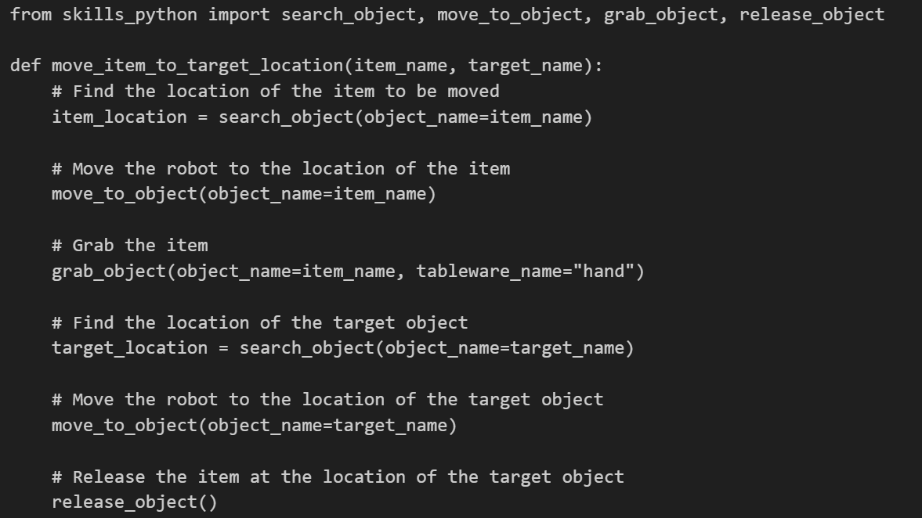
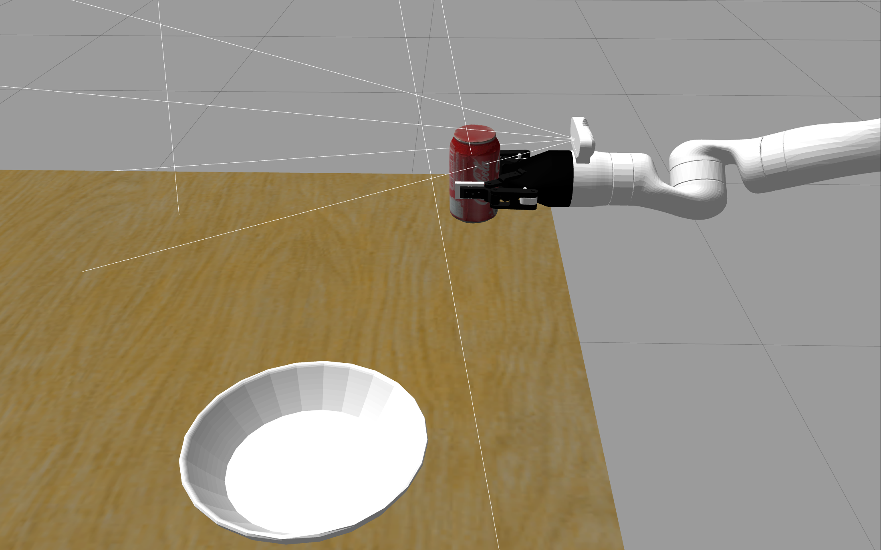
对于verification的错误
It seems that the task completion failure is due to the fact that the function did not perform any action on the objects. In order to complete the task, we need to modify the `move_item_to_target_location` function to actually move the item to the target location.
由于新生成函数缺乏对于target物体的search，所以无法移动到target物体
{'description': 'A white robotic arm is holding a can of Coca-Cola over a white plate on a wooden surface.',
'reasoning': 'The image shows a robotic arm holding a can of Coca-Cola over a white plate on a wooden surface. There is no indication that the robotic arm has successfully moved the can into the plate.',
'success': False,
'critique': 'To complete the task, the robotic arm needs to move the can of Coca-Cola into the plate.'}

Slide 34
工作总结
3/21
杨易趣

Slide 35
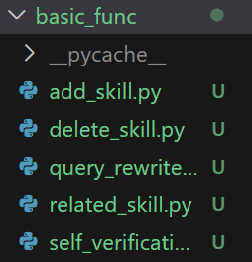
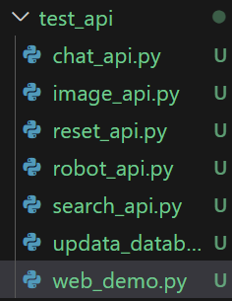
文件说明(新版)
各模块
储存所有skill描述的txt文件，并上传于技能向量库
储存所有skill描述的txt文件，并上传于技能向量库
测试单个api代码
不太重要，之前的测试中储存历史生成记录的txt文件，以及用来生成测试数据的py代码
对grounded sam 的测试
主要储存一些常量及prompt，其中还包含基础的函數
内容相同，为运行主文件！
储存负责和robot进行交互的class
可以直接导入skill函数进行检测，里面储存了一些最基本的例子
grounded_sam的运行文件，要识别物品必须先运行此文件

Slide 36
重点说明
对于测试来说务必先运行web_demo_api.py，如果使用main2等langchainchatchat有关，则还需运行
(LC) C:\Users\MSI\Desktop\langchain\Langchain-Chatchat>python startup.py -a
如果直接测试robot的准确度，可以直接调用test_move_item_to_target.ipynb文件
如果测试完整的llm生成逻辑及robot运动轨迹，则调用main.py或main.ipynb（二者内容相同）
main.py或main.ipynb所生成的response_all为basic_func/add_skill函数的输入。
temp文件夹内有各模块对应的ipynb文件，内容近似，可以用来测试。
previous_llm_yyq\skills_python\robot_info.py及previous_llm_yyq\_basic_info.py下储存着一些初始化基本信息，如果有代码的迁移问题或api变化问题等可以主要修改两个文件。
previous_llm_yyq\robot_connect.py储存了与robot进行交互的配置与基本函数，如果有新api调用或修改可以修改此文件，其中self.use_robot = True意味着调用robot，False意味着跳过调用。
运行时重点修改此处的task与选择main/main2/main3

Slide 37
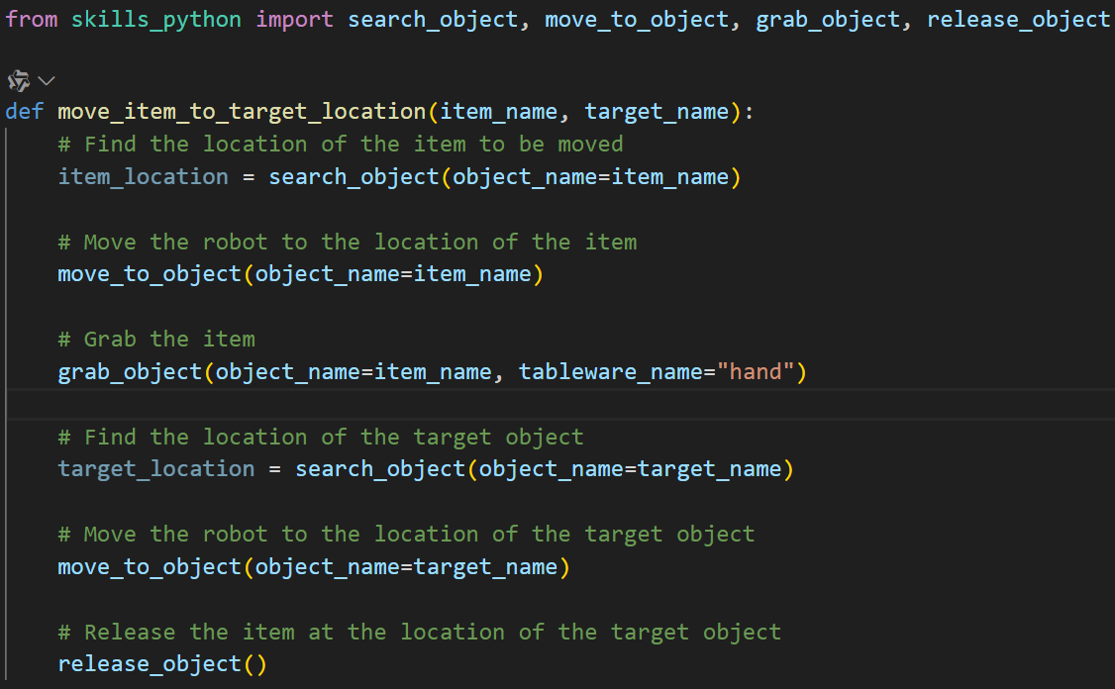
留存问题
对于 新生成的integrated skill 可以修改_basic_info.py中的SKILL_PROMPT，使得生成的函数，调用每一个函数时都进行判断是否执行成功
对于每一个调用的函数都应该判断返回值中是否包含“Fail”，如果包含的话，则返回相应的函数“Fail，because...”，如果返回值不包含“Fail”则pass
比如：

